Slide 1
Wave Reflection, Refraction and Diffraction

Slide 2
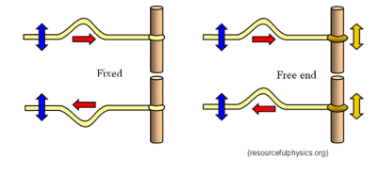
Reflection
If a wave reflects from a material that is more dense the reflected wave is inverted
If a wave reflects from a material that is less dense the reflected wave is not inverted

Slide 3
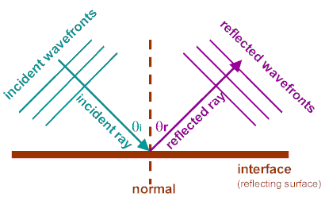
When waves reflect at an angle
The angle of incidence is the angle at which the wave strikes the surface it hits.
The angle of reflection is the angle at which the wave bounces off the surface it hits.

Slide 4
θ_{i}= θ_{r}
Incident Angle (θ) = Reflected Angle (θ)

Slide 5
Refraction
As a wave moves from one medium to another medium it is bent as the speed of that wave changes.
This change of speed and bending is related to the density and temperature of the mediums that it is moving between.

Slide 6
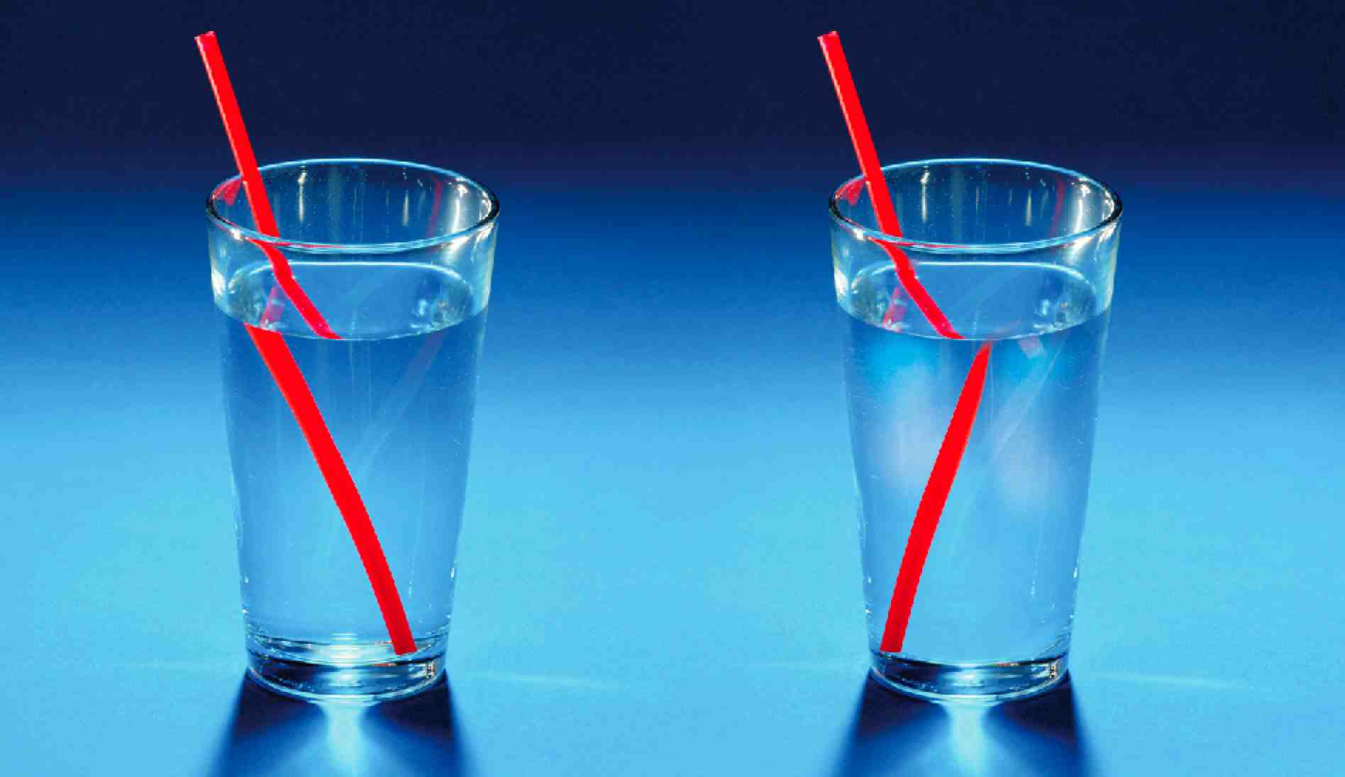
The straw looks broken because light is refracted as it moves from air to water.

Slide 7
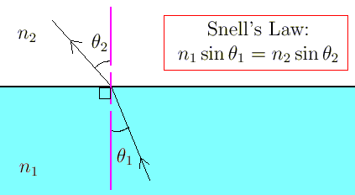
The angle of refraction depends on the angle the wave hits at (incident) and the material it is moving between.

Slide 8
Snell’s Law
Snell’s Law is used to predict how a wave will bend as it moves from one medium to another.
n₁Sin(θ)₁=n₂Sin(θ)₂
n₁=Index of refraction for the incident medium
n₂=Index of refraction for the refracted medium
θ₁=Angle of incidence
θ₂=Angle of refraction
Both incident and reflected angles are measured relative to a normal line which runs perpendicular to the surface of the 2 mediums.

Slide 9
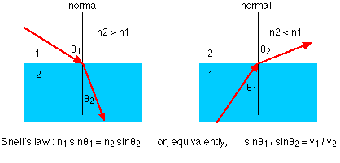
If n2 is larger than n1 the wave refracts toward the normal. If n2 is less than n1 the wave will refract away from the normal.

Slide 10
Light travels from air with an index of refraction of 1.0 into an optical fiber with an index of refraction of 1.44. (a) In which direction does the light bend? (b) If the angle of incidence on the end of the fiber is 22º, what is the angle of refraction inside the fiber? (c) Sketch the path of light as it changes media.

Slide 11
Diffraction
Diffraction occurs when a wave bends around an obstacle.
Waves with longer wavelengths diffract better than waves with shorter wavelengths.
This is why bass speakers can be places anywhere within a room without affecting its performance.

Slide 12
