Slide 1
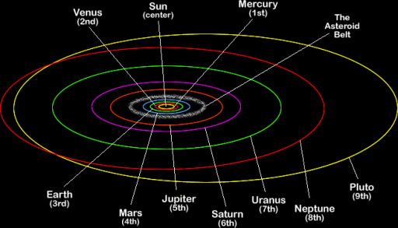
Universal Law of Gravitation

Slide 2
Newton Realized…
That the same force that attracts things toward the center of the Earth is also the same force that holds celestial objects to their orbits
He realized that every 2 objects with mass have a gravitational force that attracts them to each other that is proportional to each mass in inversely proportional the square of the distance between them.

Slide 3
Law of Universal Gravitation
Fg = GM₁M₂/r²
G is a universal constant = 6.67x10⁻¹¹Nm²/kg²
For objects on Earth one of the masses is the Mass of the Earth and r is the radius of the planet.
GM₁/r² = 9.8m/s² at Earth’s Surface.

Slide 4
This equation also explains
Why things get lighter as they move to higher elevations on Earth and heavier as they move to lower elevations.
It does not explain why astronauts are weightless in space. By Newton’s equation they should still have over 90% of their normal force of gravity acting on them while in orbit.

Slide 5
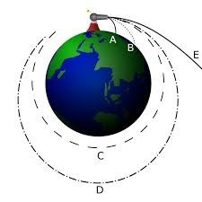
Weightlessness in Orbit
Results form ships in orbit being in constant free fall, because both the astronauts and ships are falling together it seems to them that everything is stationary and they are weightless.

Slide 6
As distances between objects doubles
The gravitational force between those objects reduces to 1/4th the initial force of gravity.
This is an inverse square relationship
If one mass doubles the force of gravity doubles, if both masses double the force of gravity quadruples.

