Slide 1
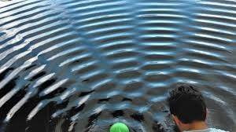
Superposition/Interference
When 2 or more waves move through a medium the resulting wave at any given point is the sum of the individual displacements

Slide 2
Superposition
In phase – 2 waves are in sync, with crests corresponding to crests and troughs to troughs
Constructive interference – when waves are in phase the resulting in the adding of the amplitudes of each. There is no effect on wavelength.

Slide 4
Superposition
Out of phase – 2 waves are opposite, with crests corresponding to troughs
Destructive interference – when waves are out of phase the resulting wave has an amplitude that results from the subtracting of each initial wave. There is no effect on wavelength.

Slide 6
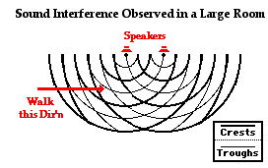
Sound Interference
Sound waves have the ability to interfere with each other both constructively and destructively.

Slide 7
Position Based
When you have multiple sound sources there are places where the compressions add together and constructively interfere.
There are also places where the compressions of one source cancel the rarefactions of the other.

Slide 8
Speakers
Because of this interference, there will be places within a room that have multiple speakers where the sound will be louder than other places.

Slide 9
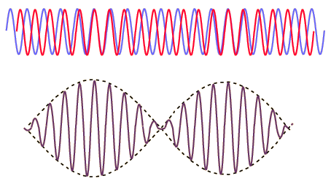
Beats
When sources have frequencies that are slightly off from each other a standing wave causing “Audible Beats” will be formed.
The number of beats per second will be equal to the difference in frequency between the sources.

Slide 10
If a two sources have frequencies of 252 and 240 Hz. How many beats per second will an observer hear.
Beat Frequency = If₁-f₂I= I(252Hz-240Hz)I=
12 Hz

Slide 11
Standing Wave
Wave that appears to oscillate but not travel as a result of interference between a wave and its reflection
Node – point that always has zero displacement, stationary
Antinode – point that has maximum displacement

Slide 13
Resonance
Every object has a “Natural Frequency” that it will vibrate at.
If energy is input into the system at the same frequency as its natural frequency the amplitude of the motion will increase.
Examples
Kicking your legs when you swing.
Running your finger around a wine glass
Shattering a glass with sound
A motion can also be dampened by inputting information out of cycle with the natural frequency.
The Tacoma Narrows Bridge Collapse is an example for failure to account for resonance in engineering.

