Slide 1
Gravitational Formation of The Solar System/Earth

Slide 2
The Earth
was formed about 4.5 billion years ago from a collection of gas an dust that was left over after the sun formed.
Our Sun itself is a second generation star, it and its planets are made from previously existing stars that died. If this where not the case heavy elements like Iron, Lead and Gold would not exist on Earth. They are only produced in Supernova Explosions of large dying stars.

Slide 4
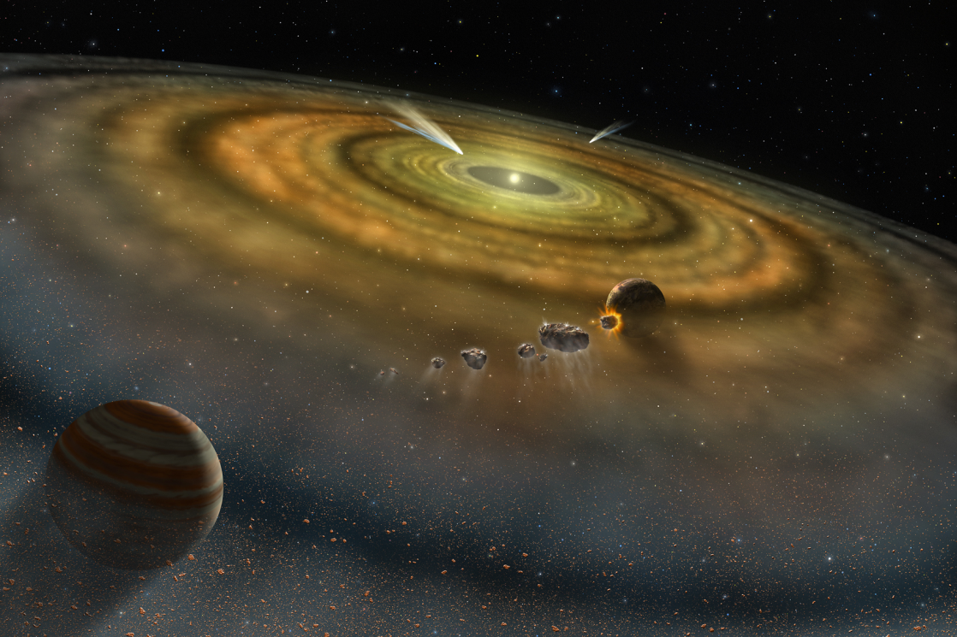
Overtime Gas and Dust
Is gravitationally attracted to each other leading it to larger and larger clumps. Eventually planets are born from this gravitational clumping process.

Slide 5
As the planets grow…
The orbits between them begin to clear.
Over time collisions between the planets and orbiting debris begin to slow down.
Our Earth still continuously hits things in space but the large collisions are very rare, this is needed for life to be sustainable.

Slide 6
Exit Slip
Write a 1-2 paragraph explanation about how the Universal Law of Gravitation is responsible for Earth’s Formation.

