Slide 1
Physics Study Guide
Acceleration and Kinematics

Slide 2
Chapter 2 Section 2
Average acceleration
Rate at which velocity changes
Ratio of change in velocity to corresponding change in time
Avg accel = change in velocity
time for change
a = Δv
Δt

Slide 3
Chapter 2 Section 2
Usually measured in m/s² but can be any unit of distance over 2 units of time
example – 10 m/s² (every second your
velocity changes by 10 m/s)
- 10 km/hs (every second your
velocity changes by 10 km/h)
- 10 km/sh (every hour your
velocity changes by 10 km/s)

Slide 4
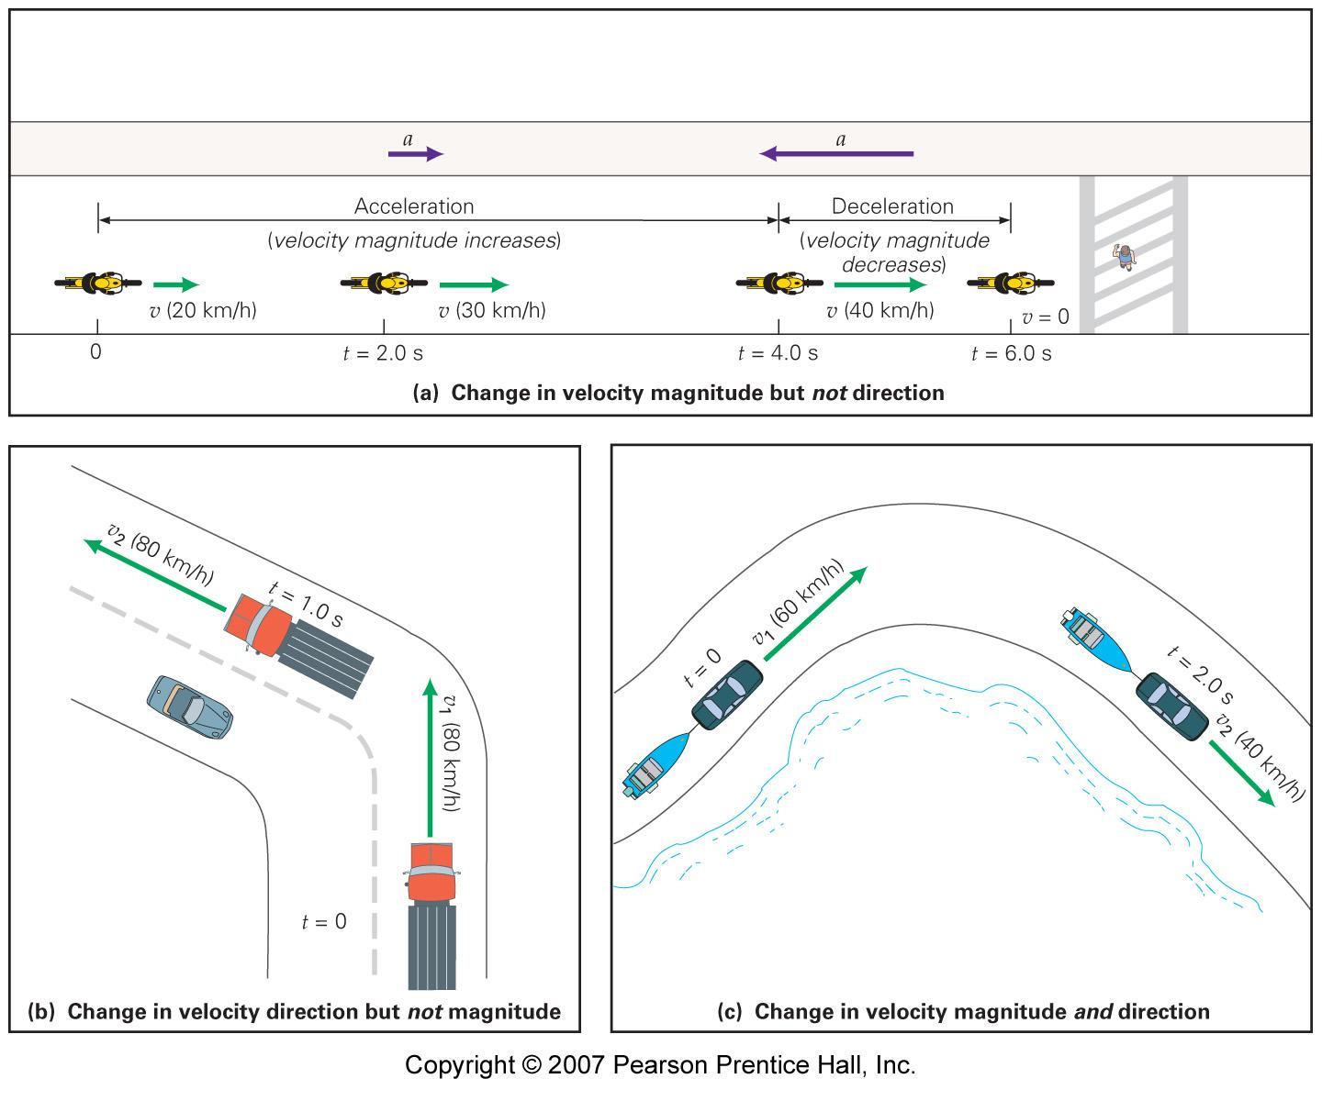

Slide 5
Chapter 2 Section 2
Should include a description of direction
Rule:
if increase in velocity the direction of a is the same as you are going
if decrease in velocity the direction of a is the opposite of the direction you are going

Slide 6
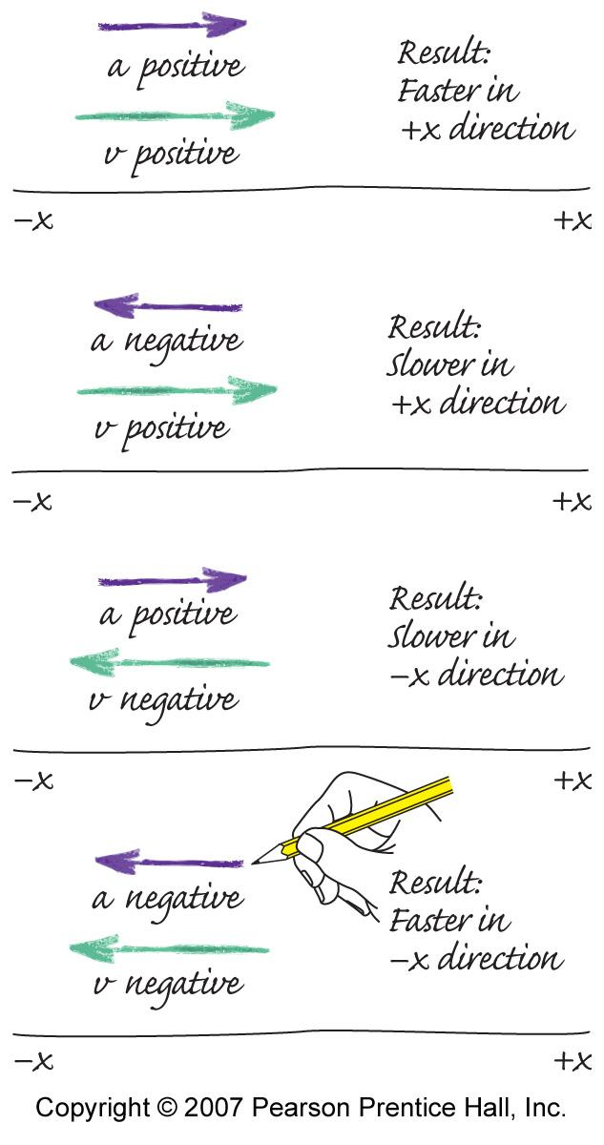

Slide 7
Chapter 2 Section 2
Turner’s treadmill runs with a velocity of 1.2 m/s and speeds up at regular intervals during a half-hour workout. After 25 min, the treadmill has a velocity of 6.5 m/s. What is the average acceleration of the treadmill during this period?

Slide 8
Chapter 2 Section 2
As the shuttle bus comes to a stop to avoid hitting a dog, it accelerates uniformly at -4.1 m/s² as it slows from 9 m/s to 0 m/s. Find the time interval of acceleration for the bus.

Slide 9
Chapter 2 Section 2
Suppose a treadmill has an average acceleration of 4.7 x 10⁻³ m/s². How much does its speed change after 5 min? If the treadmill’s initial speed is 1.7 m/s, what will its final speed be?

Slide 10
Chapter 2 Section 2
Describe the object’s motion if:
+v and +a
+v and –a
+v and 0 a
-v and +a
-v and –a
0 v and +a

Slide 11
Chapter 2 Section 2
Kinematic equations
Set of equations that can be used when acceleration is constant to describe an object’s motion
v_{o} = initial velocity v = final velocity
x = displacement a = acceleration
t = time elapsed

Slide 12
Chapter 2 Section 2
v = v_{o} + at
v² = v_{o}² + 2ax
x = v_{o}t + ½ at²
x = ½ (v₀ + v) t

Slide 13
Chapter 2 Section 2
A jet is taking off from the deck of an aircraft carrier. Starting from rest, the jet is catapulted with a constant acceleration of 31 m/s² along a straight line and reaches a velocity of 62 m/s. Find the displacement of the jet.
Notes:
13
2.2 sec

Slide 14
Chapter 2 Section 2
A speedboat has a constant acceleration of 2 m/s². If the initial velocity of the boat is 6 m/s, calculate the displacement after 8 seconds. What is the final velocity of the boat?

Slide 15
Chapter 2 Section 2
An elevator is initially moving upward at a speed of 12 m/s. The elevator experiences a constant downward acceleration of magnitude 4 m/s² for 3 s. Find the magnitude and direction of the elevator’s final velocity. How far did it move during the 3 s interval?
Notes:
15
-0.0035 m/s²
A negative acceleration doesn’t always mean the object is slowing down.

Slide 16
Chapter 2 Section 2
A spacecraft is traveling with a velocity of 3250 m/s. Suddenly the retrorocket is fired, and the craft begins to slow down with an acceleration of 10 m/s². What is the velocity of the spacecraft when the displacement of the craft is 215 km, relative to the point where the retrorocket began firing?
Notes:
16
1.4 m/s and 3.1 m/s

